Slide 1

Capstone Project – ChatBot
Koh PEI QING

Slide 2
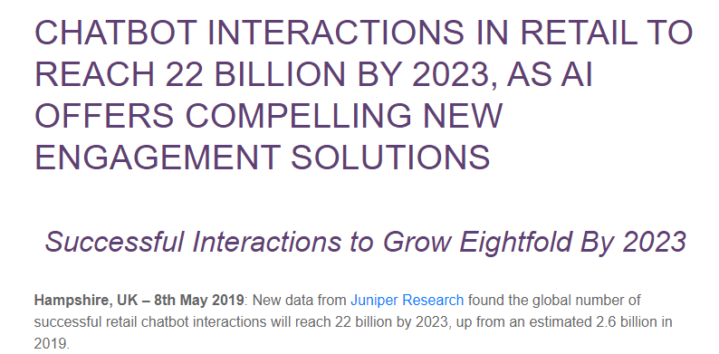
Research

Slide 3
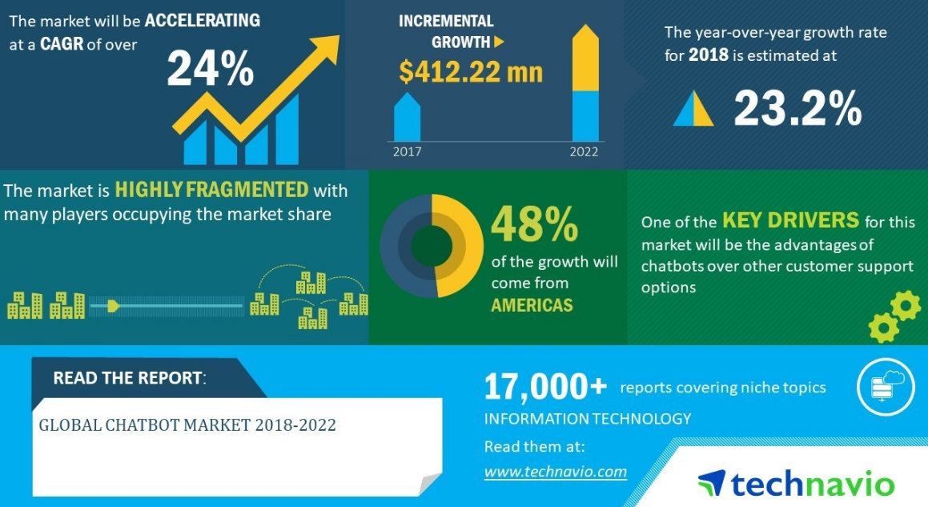
Research

Slide 4
Problem Statement:
5 airlines decided to come together to do a joint venture project of building Chatbot to help reduce operational cost and increased their sales revenue.
The project will be completed in 4 stages.
1st stage: Deal with feedback
2nd stage: Predict feedback
3rd stage: Handle general queries
4th stage: Query database
With that, being a data scientist , I was task to complete the 1st stage of the project to do a test run to see the general response and making predictions if possible.

Slide 5



Topic Modelling

Slide 6
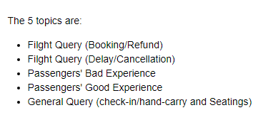
Topic Modelling

Slide 7
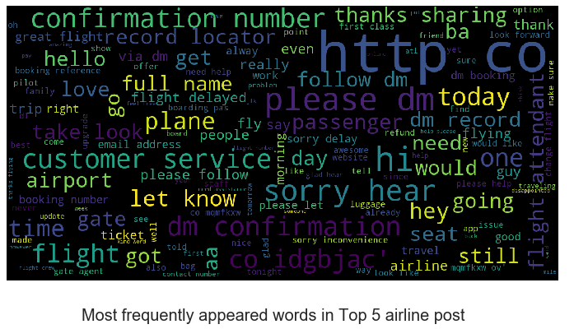
MultiClass Classification

Slide 8
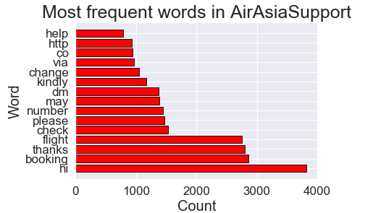
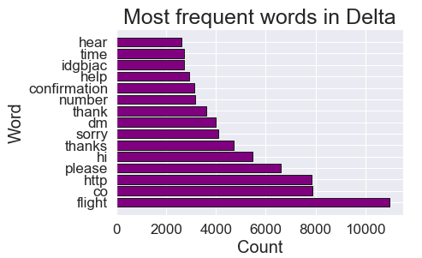
MultiClass Classification

